Slide 1
Hierarchical analysis of loops with relaxed abstract transformers
Banghu Yin Liqian Chen Jiangchao Liu Ji Wang
National University of Defense Technology, Changsha, China
11/23/2018 – NASAC 2018
Safety and Security of System Software
Notes:
Good afternoon everyone , my name is Banghu Yin. I am going to talk about our work on Hierarchical analysis of loops with relaxed abstract transformers. This work is joint with Liqian Chen Jiangchao Liu and Ji Wang.

Slide 2
Overview
Motivation
Our approach
Slicing based on hierarchical variable dependency graph
Relaxing based on partial loop invariants
An example
Implementation and Experiments
Conclusion
Comment and Response
Notes:
our report contains six parts.
We first introduce our motivation.
Then we explain our approach, and give an example to make our approach more clear.
After that we introduce our implementation and experiment.
Last two parts are the conclusion and response to the reviews’ comment.

Slide 3
Motivation

Slide 4
Loop Invariant Generation
Loop invariants are widely used to enhance the safety and security of system software
Bug finding, e.g., run-time errors
Property verification
Termination analysis …
Generating loop invariant automatically is challenging
Especially for non-linear programs
Notes:
Loop invariants are widely used to enhance the safety and security of system software. We can use loop invariant for bug finding, especially checking run-time errors. And property verification, termination analysis and so on.
However, Generating loop invariant automatically is challenging. Especially for non-linear program.

Slide 5
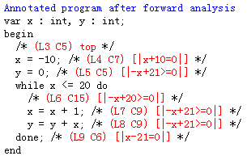
Motivation
Inferring linear loop invariant on program to enclose its non-linear behaviors under the framework of abstract interpretation
void main()
{
int x=-10, y=0;
while(x <= 20){
x=x+1;
y=y+x; // y=y+x*x*x
}
}
Result of Interproc¹
y=(x-9)(x+10)/2; x=[-10,20]
1. http://pop-art.inrialpes.fr/interproc/interprocweb.cgi
Notes:
Our motivation is:
Here is an motivating example, which has polynomial (quadratic) loop invariant. If we analyze this program by Interproc, the result is on the right figure. And at the loop head, no bound is found for variable y.

Slide 6
Motivation
Inferring linear loop invariant on program to enclose its non-linear behaviors under the framework of abstract interpretation
void main()
{
int x=-10, y=0;
while(x <= 20){
x=x+1;
y=y+x; // y=y+x*x*x
}
}
y=(x-9)(x+10)/2; x=[-10,20]
Notes:
All concrete states of this program are shown as the green points in the right figure. There is no doubt that no linear function can represent these points. However, we can use a polyhedron to enclose this non-linear states. And this polyhedron is what we want to generate.

Slide 7
Observation and Insight
Widening operator is non-monotonic
Interval domain:
[a, b] ∇ [ a′, b′] ≜ [a≤a′ ? a : -∞ , b≥ b′ ? b : +∞]
x=x0;
while(true)
//*
if(x<2) x=x+1;
If x0=[1,1], [1,1] ∇[1,2] = [1,+00);
If x0=[1,2], [1,2] ∇[1,2] = [1,2];
Analyzing less precise transfer function may return more precise invariant.
The coming problem is when and how to do Relaxing.
Notes:
Interval domain is one of the most widely used abstract domain, its widening operator is defined like that:
Like this program, if the initial value of x is [1,1], then after one iteration, all the possible value of x at the loop head is [1,2], then do widening, it returns [1,+oo]. If x_0 is [1,2], then after one iteration, all the possible value of x at the loop head is still [1,2], after widening , it still returns [1,2].
If we do relaxing on initial transfer function, and get less precise transfer function. However we may return more precise invariant.
The coming problem is when and how to do Relaxing, thus we are more likely to improve precision.

Slide 8
Observation and Insight
It is common to find hierarchical dependency relations among variables in loop bodies of
non-linear programs.
E.g., loop counter, functional variables
Low layer: x. High layer: y.
We can use the partial invariant of the low layered variable (e.g., x) to relaxing the statements assigning a high layered variable (e.g., y).
void main()
{
int x=-10, y=0;
while(x <= 20){
x=x+1;
y=y+x;
}
}
Notes:
Another observation is: It is common to find hierarchical dependency relations among variables loop bodies of non-linear programs. For example, the loop counter usually depends on itself, and the functional variables may depends on loop counter. In our motivating example, x is low layered variable, y is high layered variable.
So, We can use the partial invariant of the low layered variable (e.g., x) to relaxing the statements assigning a high layered variable (e.g., y).

Slide 9
Key idea: Hierarchical + Relaxing
P_0
P_1
P_2
P_n
…
AI
Relaxing
Partial Invariant I_0
P_1’
AI
Relaxing
Partial Invariant I_1
P_2’
…
AI
Relaxing
Partial Invariant I_n-1
P_n’
AI
Final
Invariant I_n
Notes:
Our key ider is combing hierarchical dependency anlaysis and relaxing.
Firstly, we have sliced a program into several versions, P0,P1…Pn. And P_0 only contains the lowest layered variables, P_1 contains more high layered variables than P_0. P_n contains all the varibles.
Then compute fix-point on P_0 with standard AI, and get partial invariant I_0, then we do Relaxing on P_1 with I_0, and get relaxed program P1’. We continue this process, and get the final invariant I_n.

Slide 10
Overview
Motivation
Our approach
Slicing based on hierarchical variable dependency graph (HVDG)
Relaxing based on partial loop invariants
An example
Implementation and Experiments
Conclusion
Comment and Response
Notes:
Now I will introduce our approach. First, I introduce how to do slice based on hierarchical variable dependency graph (HVDG).

Slide 11
Constructing Hierarchical Variable Dependency Graph(HVDG)
Step 1: Constructing initial VDG
1 while(t<=1000)
2 {
3 t=t + 1;
4 x=x+y+2;
5 y=y+2*x;
6 if(z+y>100)
7 z=z+y+1;
8 else
9 z=x+u;
10}
Notes:
First of all , we construct hierarchical variable dependency graph(HVDG) with the following 4 steps. Here, we use an example to explain our approach.
The first step is constructing the initial variable dependency graph from the program. For each variable, we create a node. x control depends on t, so we draw a edge from t to x, z data depends on y, so we draw a edge from y to z. Based the other control and data dependency, we can get this initial VDG.

Slide 12
Constructing HVDG
Step 2: Merging nodes

Slide 13
Constructing HVDG
Step 3: Deleting redundant edges
Final VDG

Slide 14
Constructing HVDG
Step 4: Deriving HVDG from VDG
Layer 2
Layer 1
Layer 0

Slide 15
HVDG based Program slicing
L 2
L 1
L 0
L_{<=0}:t,u
L_{<=1}:t,u,x,y
L_{<=2}:t,u,x,y,z
1 while(t<=1000)
2 {
3 t=t + 1;
4 x=x+y+2;
5 y=y+2*x;
6 if(z+y>100)
7 z=z+y+1;
8 else
9 z=x+u;
10}
1 while(t<=1000)
2 {
3 t=t + 1;
4
5
6
7
8
9
10}
1 while(t<=1000)
2 {
3 t=t + 1;
4 x=x+y+2;
5 y=y+2*x;
6
7
8
9
10}
1 while(t<=1000)
2 {
3 t=t + 1;
4 x=x+y+2;
5 y=y+2*x;
6 if(z+y>100)
7 z=z+y+1;
8 else
9 z=x+u;
10}
Program P
Sliced Version P0
Sliced Version P1
Sliced Version P2

Slide 16
Overview
Motivation
Our approach
Slicing based on hierarchical variable dependency graph (HVDG)
Relaxing based on partial loop invariants
An Example
Implementation and Experiments
Conclusion
Comment and Response

Slide 17
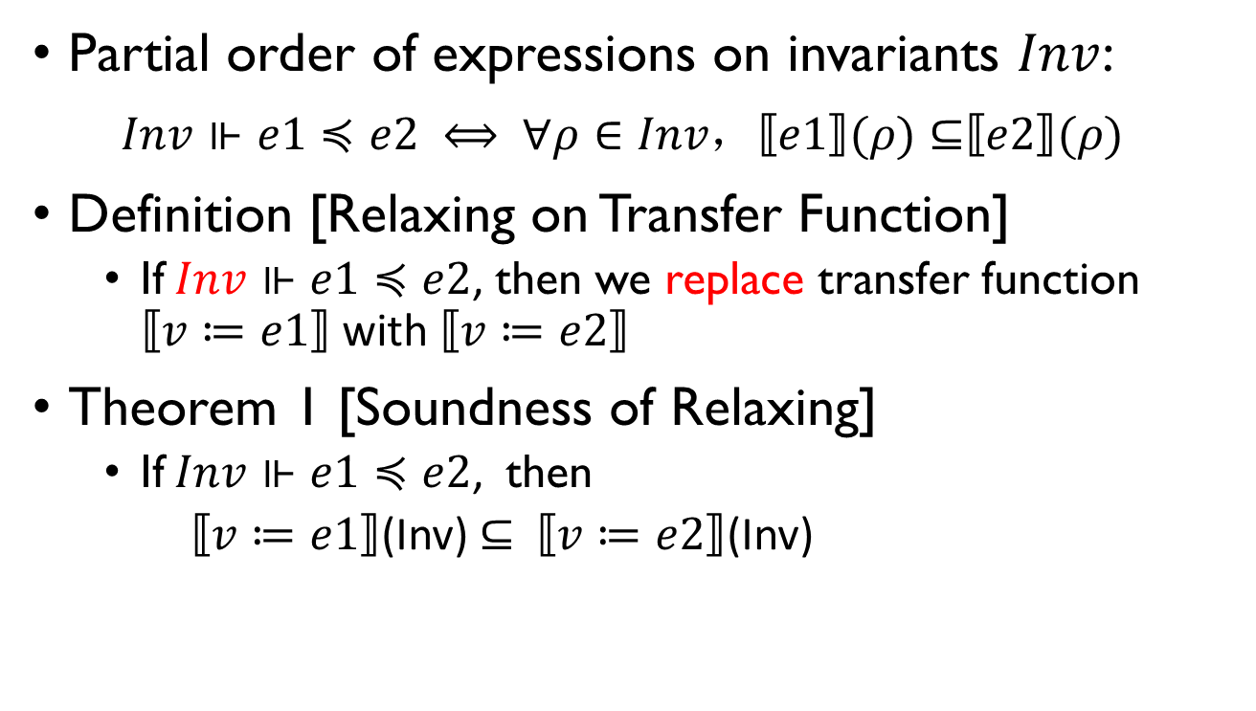
Relaxing Operator
Partial order of expressions on invariants $Inv$:
$Inv⊩e1≼e2 ⟺ ∀ρ∈Inv，⟦e1⟧(ρ)⊆⟦e2⟧(ρ)$
Definition [Relaxing on Transfer Function]
If $Inv⊩e1≼e2$, then we replace transfer function $⟦v≔e1⟧$ with $⟦v≔e2⟧$
Theorem 1 [Soundness of Relaxing]
If $Inv⊩e1≼e2$, then
$⟦v≔e1⟧$(Inv) $⊆$ $⟦v≔e2⟧$(Inv)
Inv is partial invariants, which is generated by pre-analysis on lower layered sliced program.
Notes:
Our relaxing operator is defined on partial order of expressions. The basic idea is replacing a transfer function with a less precise one. And we have proved the soundness of our relaxing. More details can be found in our paper.
Note that. Inv is partial invariants.

Slide 18
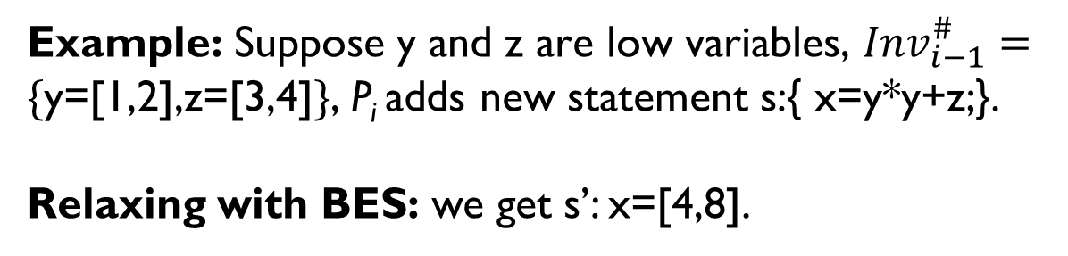
Relaxing Strategies
Relaxing based on bounds of expressions
Relaxing all bounded expressions with values from partial invariants. (Bounded Expressions strategy(BES))
BES is a general strategy for any programs
Example: Suppose y and z are low variables, ${Inv}_{i−1}^{\#}=\{$y=[1,2],z=[3,4]$\}$, P_{i} adds new statement s:{ x=y*y+z;}.
Relaxing with BES: we get s’: x=[4,8].

Slide 19
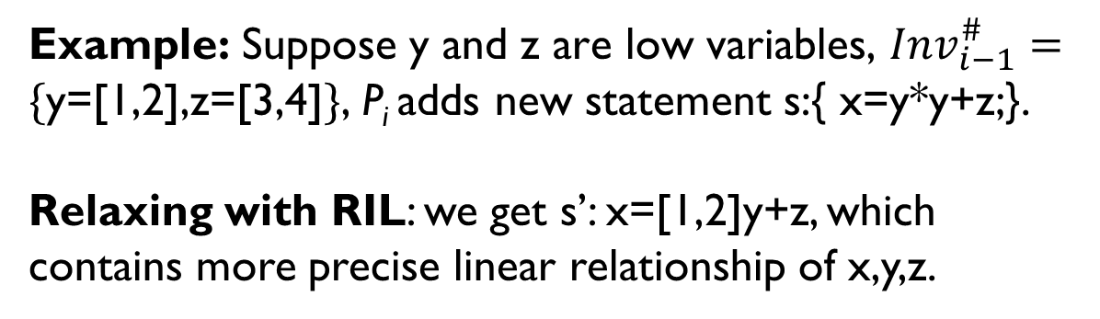

Relaxing Strategies
Relaxing based on interval linearization (RIL)
RIL relaxes expressions into interval affine forms:
$i_{0}+\sum_{k}{(i_{k}×V_{k})}$, where $i_{k}$ is an interval.
RIL is a strategy for program with polynomial invariant
Example: Suppose y and z are low variables, ${Inv}_{i−1}^{\#}=\{$y=[1,2],z=[3,4]$\}$, P_{i} adds new statement s:{ x=y*y+z;}.
Relaxing with RIL: we get s’: x=[1,2]y+z, which contains more precise linear relationship of x,y,z.

Slide 20

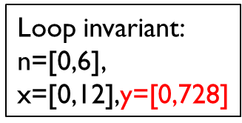
Relaxing Strategies
Relaxing based on one-variable interval linear form
One-variable interval linear form (OVILF)
$v_{k} =i_{1}×v_{k}+i_{2}$;
（where $i_{1}$ and $i_{2}$ are interval constants）
Solving OVILF by Formula Method (FM)
Relaxing OVILF is a strategy for program with exponential invariants
1 int x=0,y=0,n=0;
2 while(x<=12){
3 x=x+2;
4 if(*)
5 y=2*y+1;
6 else
7 y=3*y+2;
8 n=n+1;
9 }
Relaxing
Abstracted OVILF:
x=x+2;
y=[2,3]y+[1,2];
n=n+1;
Solving by FM
Loop invariant:
n=[0,6], $\text{x}\text{=[0,12],}\text{y}\text{=[0,728]}$
Notes:
OVILF has two features: first the statement only includes one variable. Second, the whole loop body only assign this variable once. Thus we can solve this loop with Formula Method.

Slide 21
Overview
Motivation
Our approach
Slicing based on hierarchical variable dependency graph (HVDG)
Relaxing based on partial loop invariants
An example
Implementation and Experiments
Conclusion
Comment and Response

Slide 22
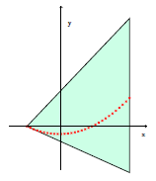
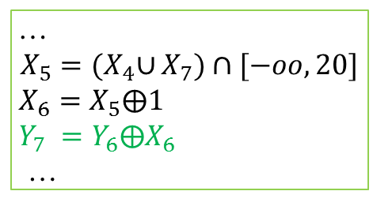
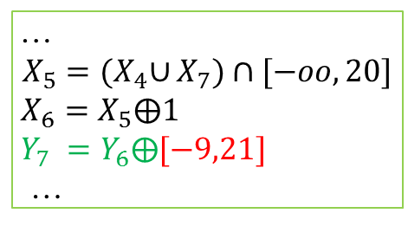
An Example
…
$$X_{5}={(X}_{4}∪X_{7})∩[−oo, 20]$$
$X_{6}=X_{5}⨁1$
$Y_{7} =Y_{6}⨁X_{6}$
…
1 void main()
2 {
3 int x=-10, y=0;
4 while(x <= 20){
5 x=x+1;
6 y=y+x; //(*)
7 }
8 }
y
For P1, we get
x=[-9,21] at
point 6 by AI.
Relaxing
x
…
$$X_{5}={(X}_{4}∪X_{7})∩[−oo, 20]$$
$X_{6}=X_{5}⨁1$
$Y_{7} =Y_{6}⨁[−9,21]$
…
HVDG
1 void main()
2 {
3 int x=-10;
4 while(x <= 20){
5 x=x+1;
6
7 }
8 }
1 void main()
2 {
3 int x=-10, y=0;
4 while(x <= 20){
5 x=x+1;
6 y=y+x; //(*)
7 }
8 }
Loop head:
x=[-10,21];
9x+y+90>=0;
21x-y+210>=0
P1
P2

Slide 23
Overview
Motivation
Our approach
Slicing based on hierarchical variable dependency graph (HVDG)
Relaxing based on partial loop invariants
An example
Implementation and Experiments
Conclusion
Comment and Response

Slide 24
Implementation and Experiment
Implementation
A prototype analyzer RelaxAIer, on top of Interproc.
Abstract domain: Box (interval) and Polka (polyhedra)
Benchmarks (46 nonlinear programs)
NLA¹(Nonlinear Algorithmic) Benchmark (35 programs )
Other 11 programs from 3 literatures
Sankaranarayanan et al[POPL’04], Sharma et al[ESOP’13], Kincaid et al[POPL’18]
1. https://bitbucket.org/nguyenthanhvuh/nguyenthanhvuh.bitbucket.io/wiki/research

Slide 25
Implementation and Experiments
RQ1: How frequently can loop variables in non-linear programs be partitioned into multiple layers?
40 out of 46 programs (around 87.0%) have at least 2 hierarchical layers among variables.
P | #V | #L | P | #V | #L | P | #V | #L
mul2 | 2 | 2 | fermat2 | 3 | 1 | ps4 | 3 | 3
prod | 3 | 3 | knuth | 5 | 1 | ps5 | 3 | 3
cohendiv | 6 | 3 | lcm | 4 | 2 | ps6 | 3 | 3
mannadiv | 3 | 2 | lcm2 | 4 | 2 | geo1 | 3 | 2
divbin | 3 | 3 | illinois | 4 | 3 | geo2 | 3 | 2
hard | 4 | 2 | berkeley | 4 | 3 | geo3 | 3 | 2
wensley | 4 | 2 | firefly | 4 | 3 | gauss | 4 | 2
dijkstra | 4 | 2 | mesi | 4 | 3 | reduction | 6 | 3
sqrt | 3 | 2 | moesi | 5 | 3 | reduction_linear | 6 | 3
z3sqrt | 3 | 1 | prod4br | 4 | 3 | const_product | 4 | 3
freire1 | 2 | 1 | readers_writers | 3 | 2 | fibonacci | 3 | 2
freire2 | 3 | 1 | cohencu | 4 | 4 | exp_with_linear | 4 | 3
euclidex1 | 9 | 3 | petter | 2 | 2 | exp_add_linear | 3 | 3
euclidex2 | 6 | 2 | ps1 | 3 | 2 | exp_add_loop | 2 | 2
euclidex3 | 11 | 4 | ps2 | 3 | 3
fermat | 3 | 1 | ps3 | 3 | 3
Notes:
40 out of 46 programs (around 87.0%) have at least 2 hierarchical layers among variables. For these 40 program, 104/40 = 2.6 layers/programs.

Slide 26
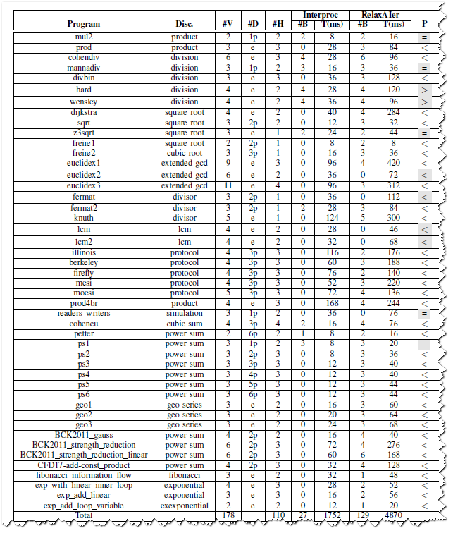
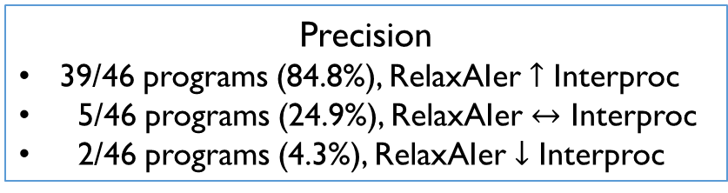
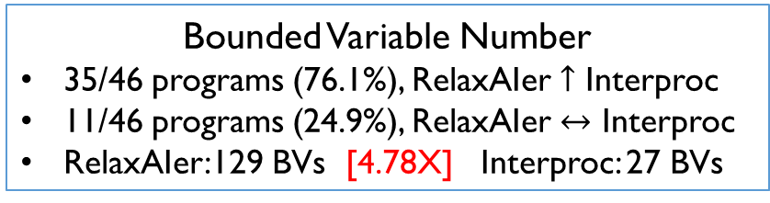
Implementation and Experiments
RQ 2: How effective is our technique in improving the precision of abstract interpretation on benchmarks?
Our method obviously generates more precise invariants than standard abstract interpretation for non-linear programs, with reasonable extra time overhead.
Bounded Variable Number
35/46 programs (76.1%), RelaxAIer $↑$ Interproc
11/46 programs (24.9%), RelaxAIer $↔$ Interproc
RelaxAIer:129 BVs [4.78X] Interproc: 27 BVs
Precision
39/46 programs (84.8%), RelaxAIer $↑$ Interproc
5/46 programs (24.9%), RelaxAIer $↔$ Interproc
2/46 programs (4.3%), RelaxAIer $↓$ Interproc
Time for analyzing 46 programs
RelaxAIer: 4870ms (Average 105.9ms)
[2.78X]
Interproc: 1752ms (Average 38.1ms)

Slide 27
Conclusion

Slide 28
Contributions
A hierarchical analysis framework to infer loop invariants based on relaxed abstract transformers.
HVDG based program slicing
Relaxing operator
Partial Invariant
Hierarchical loop analysis framework
Notes:
We present a hierarchical analysis framework to infer loop invariants based on relaxed abstract transformers.
We propose a hierarchical variable dependency graph (HVDG) based loop slicing technique.
We present three strategies for relaxing abstract transformers based on the partial invariants.
We have implemented the proposed approach in a tool called RelaxAIer which achieves promising results.

Slide 29
Future Work
We will consider more relaxing strategies.
Apply out technique to more applications such as complexity/resource bound analysis, WCET analysis, etc.

Slide 30
Comment and Response

Slide 31
Comment and Response
1. Why do you compare RelaxAIer with interproc only?
There are several reasons why in this paper, we compare RelaxAIer with Interproc. First, Interproc is one of the available state-of-the-art invariant generation tools based on abstract interpretation, which is widely used in the literature. Second, in this paper, RelaxAIer is implemented based on Interproc, thus we can make sure that the improvement that RelaxAIer achieves is owing to our new technique.
To make it clearer, in the revised version, we have added explanations about the relationship between RelaxAIer and Interproc in Paragraph 1, Section VI (on page 8).

Slide 32
Comment and Response
2. What unstable variables/expressions mean?
Unstable variables/expressions mean that the variables/expressions change their value during the loop iterations.
For example, {x=0; while(x<10) x=x+1;}, where x’s value in the loop is changed during each iteration. Our technique relaxes the value of x into [0, 9] at the loop head, which is always hold during each iteration, so its value is stable in the given abstract domain. We have added a brief explanation at the end of Paragraph 2 of Section II (on Page 2).

Slide 33
Comment and Response
3. Could you give some examples to explain “RelaxAIer get less precise than Interproc”?
We have explained the reason, also have added an example, i.e., “Example 9”, in Section VI (on Page 10) to make this claim more clear.
1 void main(){
2 int x = 128;
3 int y = 0;
4 while(x >= 1){
5 x = x/2;
6 y = y-x;
7 }
8 }
Interproc with Polka domain:
x=[1,128], x-y=128, y=[-127,0]
RelaxAIer with Polka:
x=[1,128],y=[-oo,0]

Slide 34
Comment and Response
4. Are layered loop variables the reason why “RelaxAIer” does better than “Interproc”?
Our approach takes both the benefits of hierarchical analysis and relaxing techniques. Layered loop variable help RelaxAIer to decide when and how to do relaxing on transfer functions, which makes relaxing more effectively and efficiently.
To make this claim clearer, we have added Paragraph 2 on Page 3 (in Section II) to explain this problem.

Slide 35
Thank you
Any Questions?

